Slide 1
Virtual Design Review 4
Convertible High Heel Shoe
D. Brown – O. Jegede

Slide 2
Team Introductions
Review of Fall 2017 Work
inNOLEvation Challenge
Overview
Prototype V1
Future Work
Oladipo Jegede

Slide 3
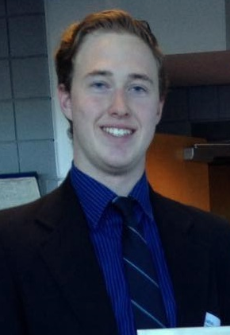
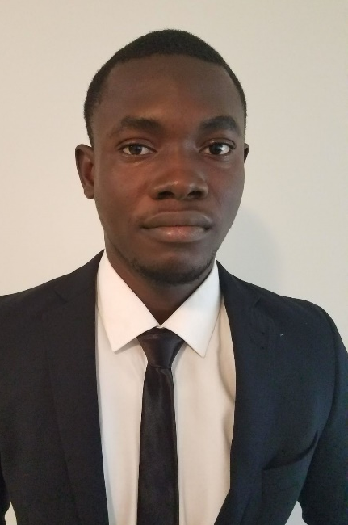
Introductions
Team Leader
Kali J. Nelson
ME Student
Lead ME
Dalton C. Brown
ME Student
Financial Advisor
Olapido A. Jegede
ME Student
Oladipo Jegede

Slide 4
Fall 2017: The Problem
Heels cause foot pain after extended periods.
9 in 10 women have walked barefoot due to heels.
Women carry an extra pair of shoes.
Oladipo Jegede

Slide 5
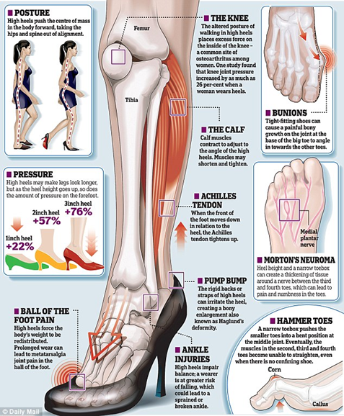
Fall 2017: The Problem
Short term and long term heel use can lead to a variety of medical conditions.
Heels cause unnatural posture.
Pressure on forefoot is increases as heel height increases.
Oladipo Jegede

Slide 6
Fall 2017: Project Summary
The team is tasked with designing convertible shoe that can transition between a flat state and a high heel state.
The convertible shoe will be fashionable, comfortable, and inexpensive.
Oladipo Jegede

Slide 7
inNOLEvation Challenge
Event | Date | Status
Intent to Compete | November 3rd, 2017 | Completed
Business Model Canvas | January 16th, 2018 | Completed
Final Business Model Canvas | February 8th, 2018 | Completed
Business Pitch Presentation | February 9th, 2018 | Completed
Oladipo Jegede

Slide 8
InNOLEvation Challenge: Business Model Canvas
Key Partners | Key Activites | Value Propositons |  | Customer Relationships | Customer Segments
FAMU-FSU College of Engineering - Shoe Manufacturer | Build and test selected prototype Patent Design Focus on Web Development | Comfort Can easily transition between fashionable state and flat state to alleviate pressure caused by heels. |  | Easy exchanges Favorable customer service Self-service | Women
 | Key Resources |  |  | Channels
 | Investors Strong Employee Base Return Customers Marketing Plan |  |  | Social Media, particularly Instagram and YouTube (have potential to partner with famous beauty blogger); own website; advertisement both digital and physical (in magazines targeted towards women, Cosmopolitan, Seventeen, Elle, Glamour)
Cost Structure |  |  | Revenue Streams
Start-up cost (cost to prototype and test); advertising cost (cost to acquire a customer); patenting cost; cost to acquire product (product cost per piece); upsell cost (sell different heel types); shipping costs; marketing costs; branding |  |  | $1000 from the FAMU-FSU College of Engineering Shoe revenue of 4X the Direct Cost
Oladipo Jegede

Slide 9
Key Partners | Key Activites | Value Propositons |  | Customer Relationships | Customer Segments
FAMU-FSU College of Engineering - Shoe Manufacturer | Build and test selected prototype Patent Design Focus on Web Development | Comfort Can easily transition between fashionable state and flat state to alleviate pressure caused by heels. |  | Easy exchanges Favorable customer service Self-service | Women
 | Key Resources |  |  | Channels
 | Investors Strong Employee Base Return Customers Marketing Plan |  |  | Social Media, particularly Instagram and YouTube (have potential to partner with famous beauty blogger); own website; advertisement both digital and physical (in magazines targeted towards women, Cosmopolitan, Seventeen, Elle, Glamour)
Cost Structure |  |  | Revenue Streams
Start-up cost (cost to prototype and test); advertising cost (cost to acquire a customer); patenting cost; cost to acquire product (product cost per piece); upsell cost (sell different heel types); shipping costs; marketing costs; branding |  |  | $1000 from the FAMU-FSU College of Engineering Shoe revenue of 4X the Direct Cost

Slide 10
The Design Problem
Heel Mechanism
Changeable angle of inclination
Changeable exterior fabric around ball of foot
Dalton Brown

Slide 11
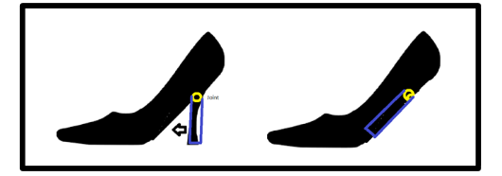
Concept Generation
Description: Uses a hinge or joint that allows the heel to pivot
Pros: Simple to implement, no removable parts
Cons: Requires thick sole
Description: Sole flexibility is in state of tension when elevated and in state of compression when flat to accommodate change in heel angle.
Pros: Simple to design
Cons: Vulnerable to external hazards
Dalton Brown

Slide 12
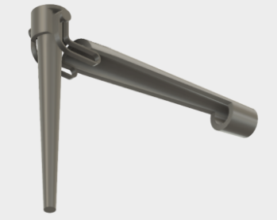
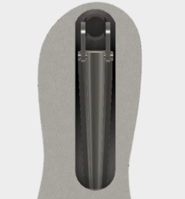
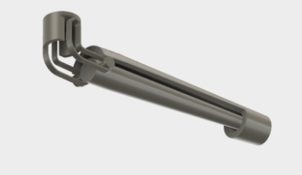
First CAD Model
Dalton Brown

Slide 13
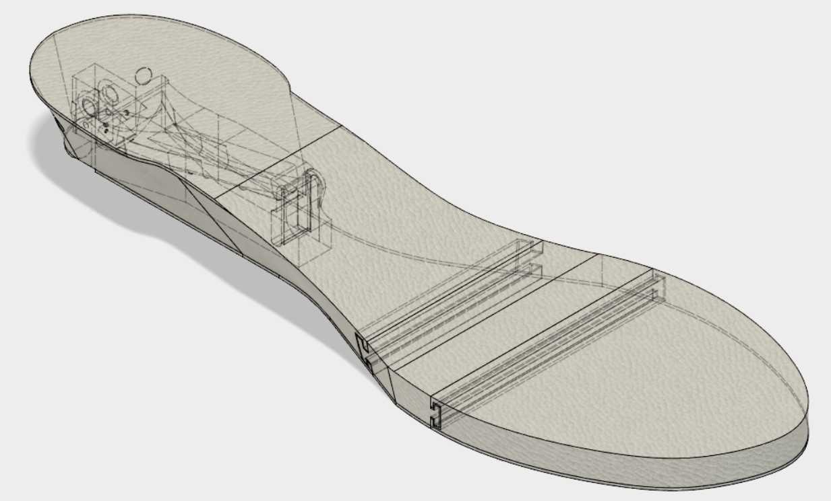
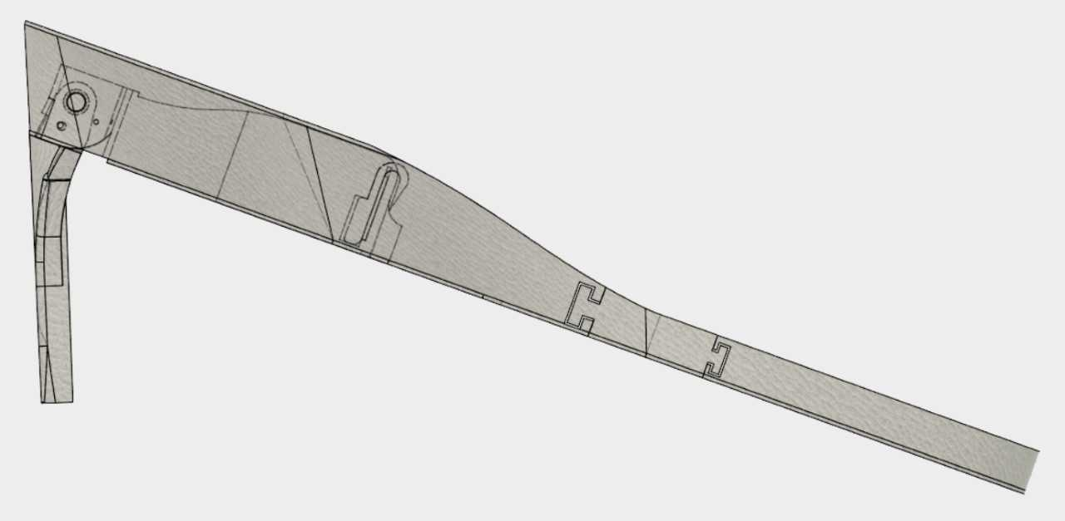
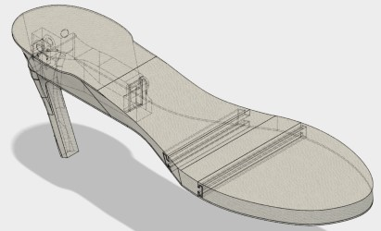
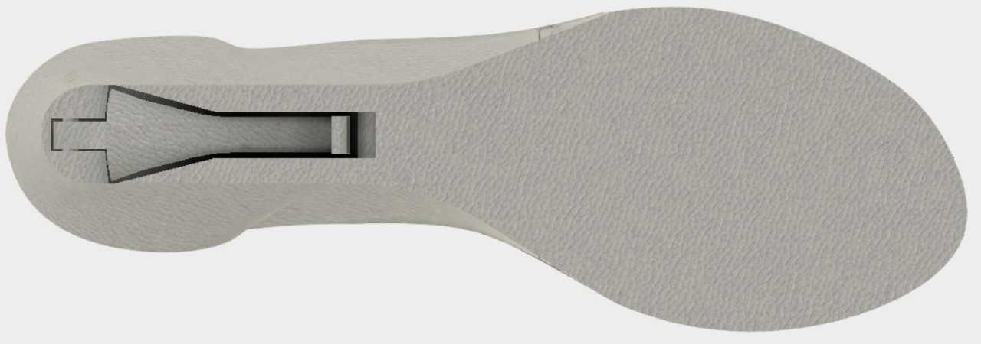
Prototype V1
Dalton Brown

Slide 14
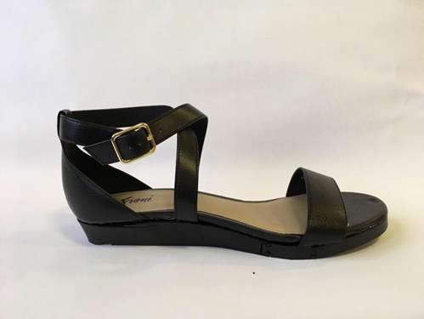
Prototype V1
Dalton Brown

Slide 15
Prototype V1: Target Summary
Target Summary | Metric | Target | Actual
Heel Height (Elevated) | Inches | > 3 | 3.75
Heel Height (Flat) | Inches | < 0.5 | 0.95
Shoe Size | US Standard Shoe Size | 10 ½ | 10 ½
Slippage Avoidance | Coefficient of Friction | > 0.3 | N/A
Cost to Customer | US Dollars | < 150 | N/A
Ease of Transformation | Number of Steps | 4 | 2
Dalton Brown

Slide 16
Future Work: Material Selection
Polymers
Rubbers, Plastics (PVC or PUE)
Very good tensile strength
Good toughness strength
Composites
Woods
Used for Heel
Good compressive strength
Dalton Brown

Slide 17
Future Work: Standardization of Shoe Design
Once design for 10 ½ sized shoe is finalized, design needs to standardized for mean 95th Percentile of women.
Taken from a study by Footwear Market Insights (n=524809000 )
Dalton Brown

Slide 18
Future Work: Engineering Shark Tank
Business Pitch Competition similar to inNOLEvation Challenge.
Executive Summary of Business Plan needs to be written.
Dalton Brown

Slide 19
Summary
Prototype 1 is complete and proves viability of design.
Team placed in Top 15 for the inNOLEvation Challenge.
Team is working on material selection for Prototype 2.
Standardization of design can take place once design is finalized.
Team is participating in Engineering Shark Tank.
Dalton Brown

Slide 20
References
https://books.google.com/books?id=xLVUjzkK3rgC&printsec=frontcover&vq=191#v=onepage&q=191&f=false

Slide 21
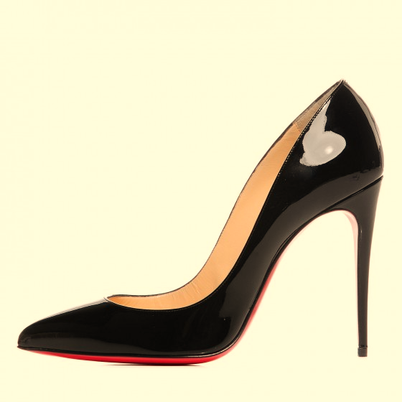
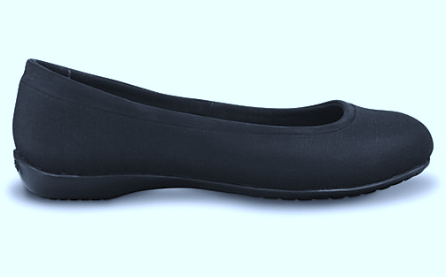
Questions?

